Slide 1

Professor Power Index
Kelly-Marie Yokuda
April 11th, 2023
BrainStation Capstone Final Presentation
in/yokudak

Slide 2
Is publishing high all about who you know?

Slide 3
Defining Target Variable

Slide 4
Data Cleaning Overview

Slide 5
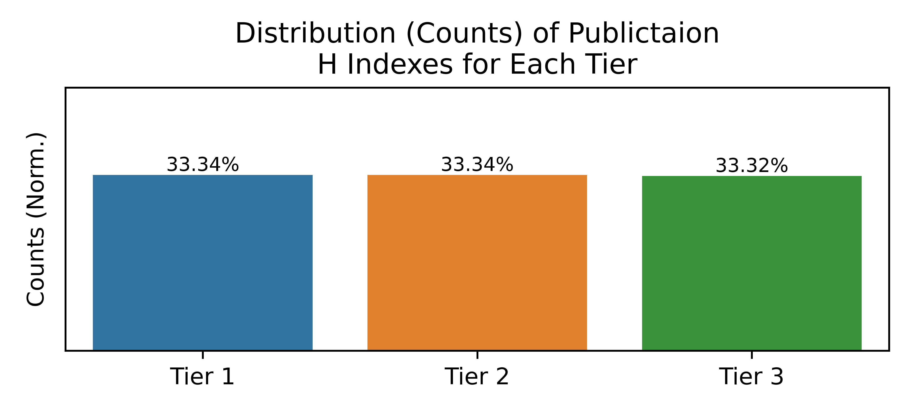

Defining Target Variable
Sort observations into three tiers according to H index
Higher Tier → Higher Publication Prestige
Uniform distribution of observations

Slide 6
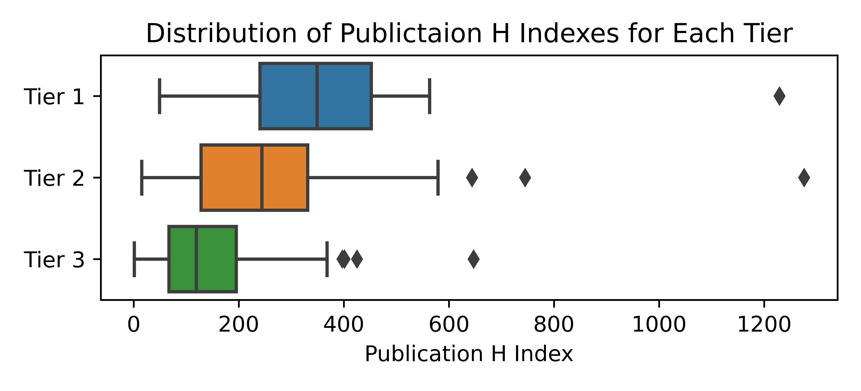
Defining Target Variable
Sort observations into three tiers according to H index
Higher Tier → Higher Publication Prestige
Findings
Tiers have overlapping ranges, could lead to classification issues later on.
Median & IQR increase with Tier level.
Example: Outlier could be better classified in Tier 2?
As Tier Level ↑ Variation in Data ↑
Mismatch Variation → More Classification issues

Slide 7
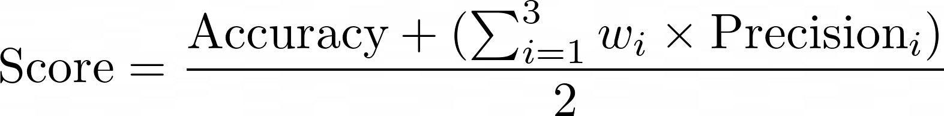
Evaluating Models
Goal: Classify Publication Entries into 3 Tiers of Prestige, using only metrics of the authors.
Scoring Function: Average of Accuracy and Weighted Precision
  Want to achieve a accurate classification while also minimizing as much false positives as much as possible.
“Custom Score”

Slide 8
Evaluating Models
Goal: Classify Publication Entries into 3 Tiers of Prestige, using only metrics of the authors.
Scoring Function: Average of Accuracy and Weighted Precision
  Want to achieve a accurate classification while also minimizing as much false positives as much as possible.
“Custom Score”

Slide 9
Evaluating Models
Goal: Classify Publication Entries into 3 Tiers of Prestige, using only metrics of the authors.
Scoring Function: Average of Accuracy and Weighted Precision
  Want to achieve a accurate classification while also minimizing as much false positives as much as possible.
“Custom Score”

Slide 10
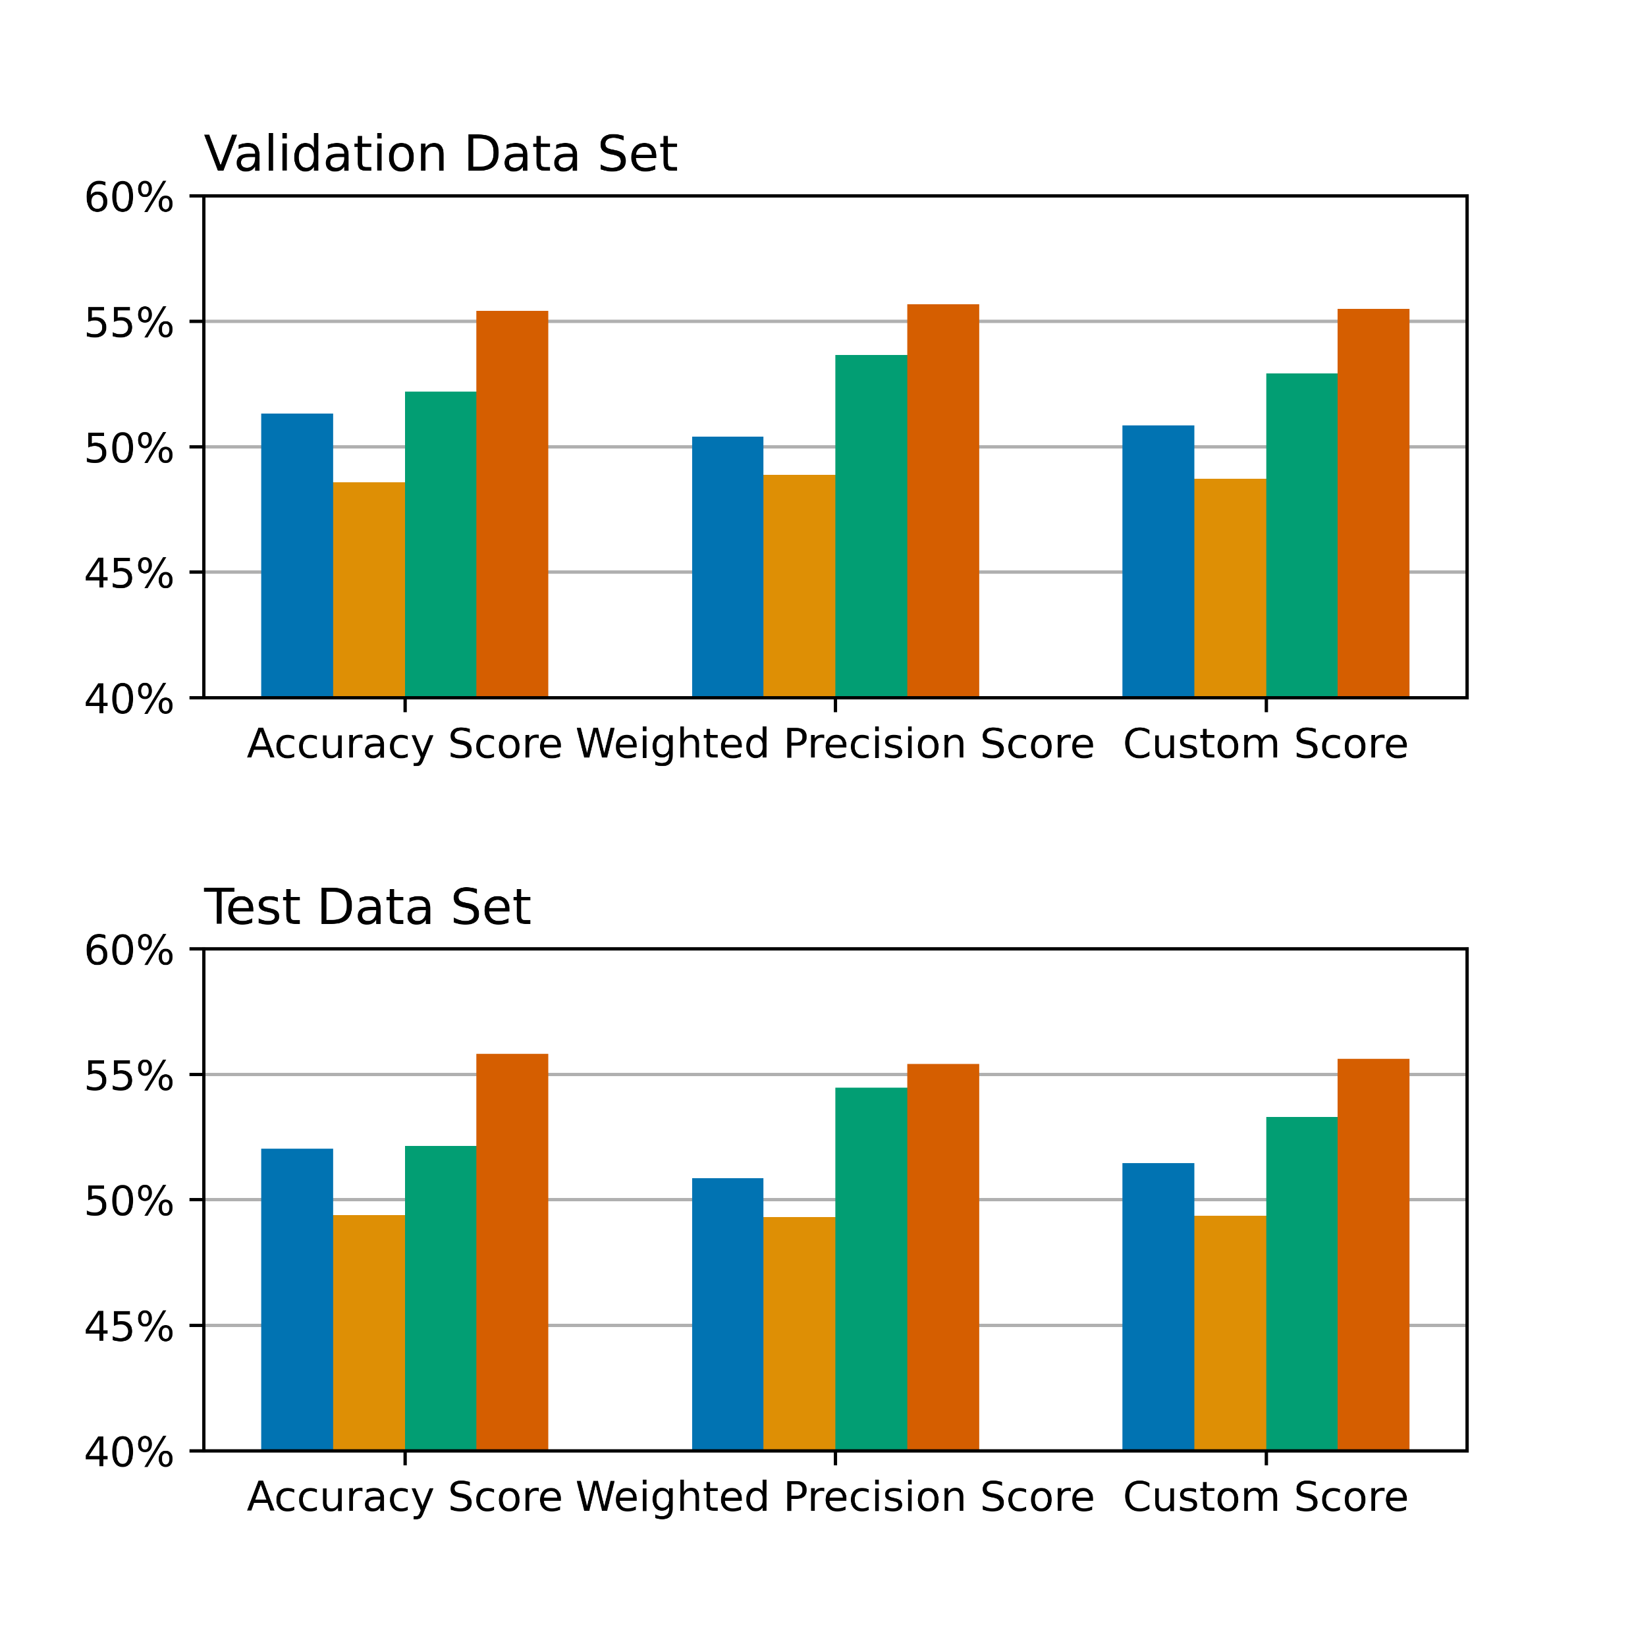

Evaluating Models
General Findings
For any model, accuracy or precision could not exceed 56%
Weighted precision and accuracy scores agree with results from Custom Score

Slide 11
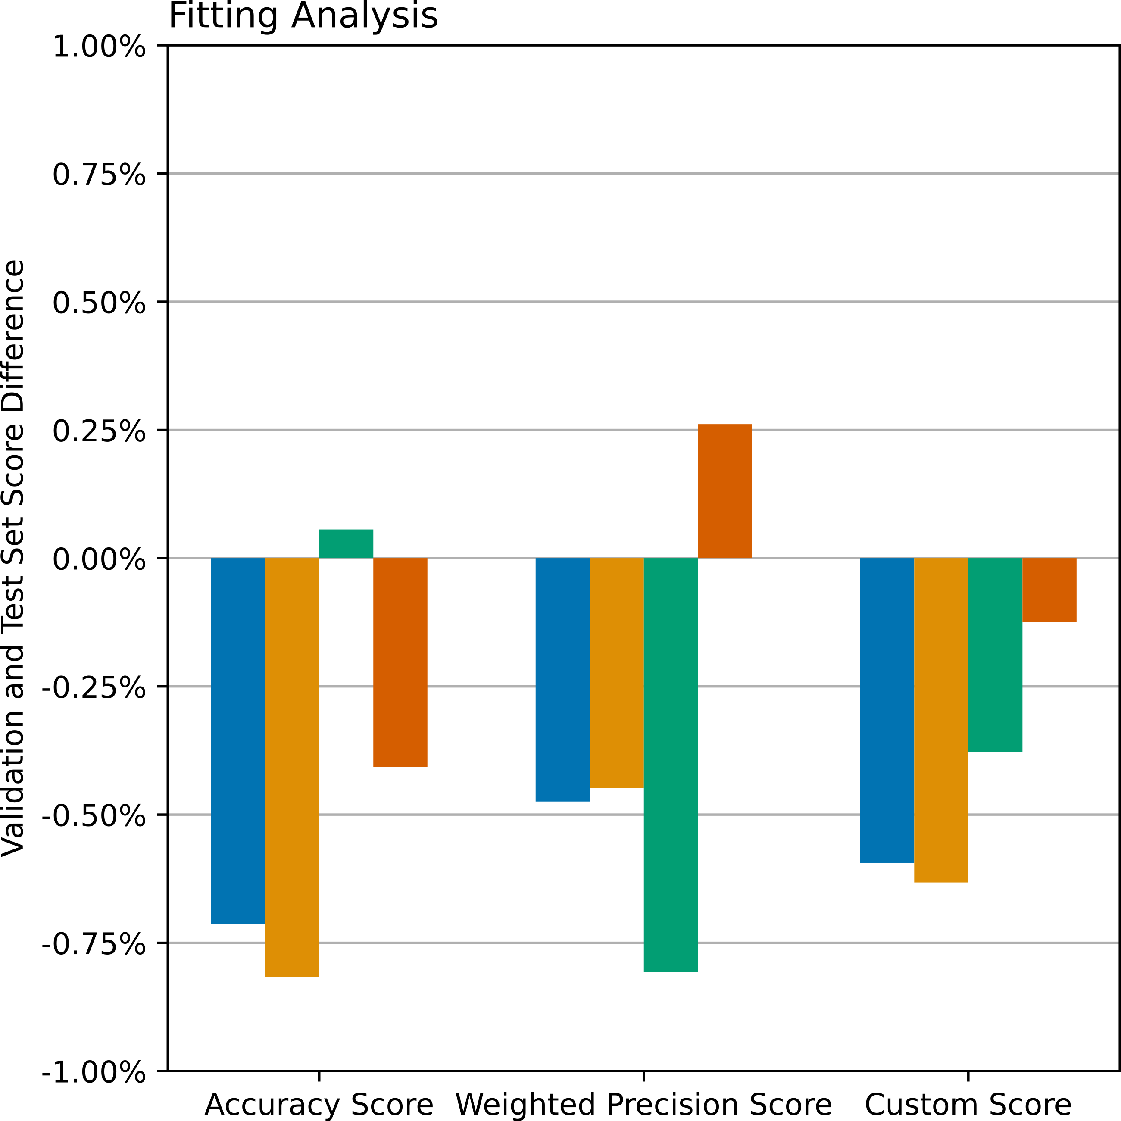
Evaluating Models
General Findings

Slide 12
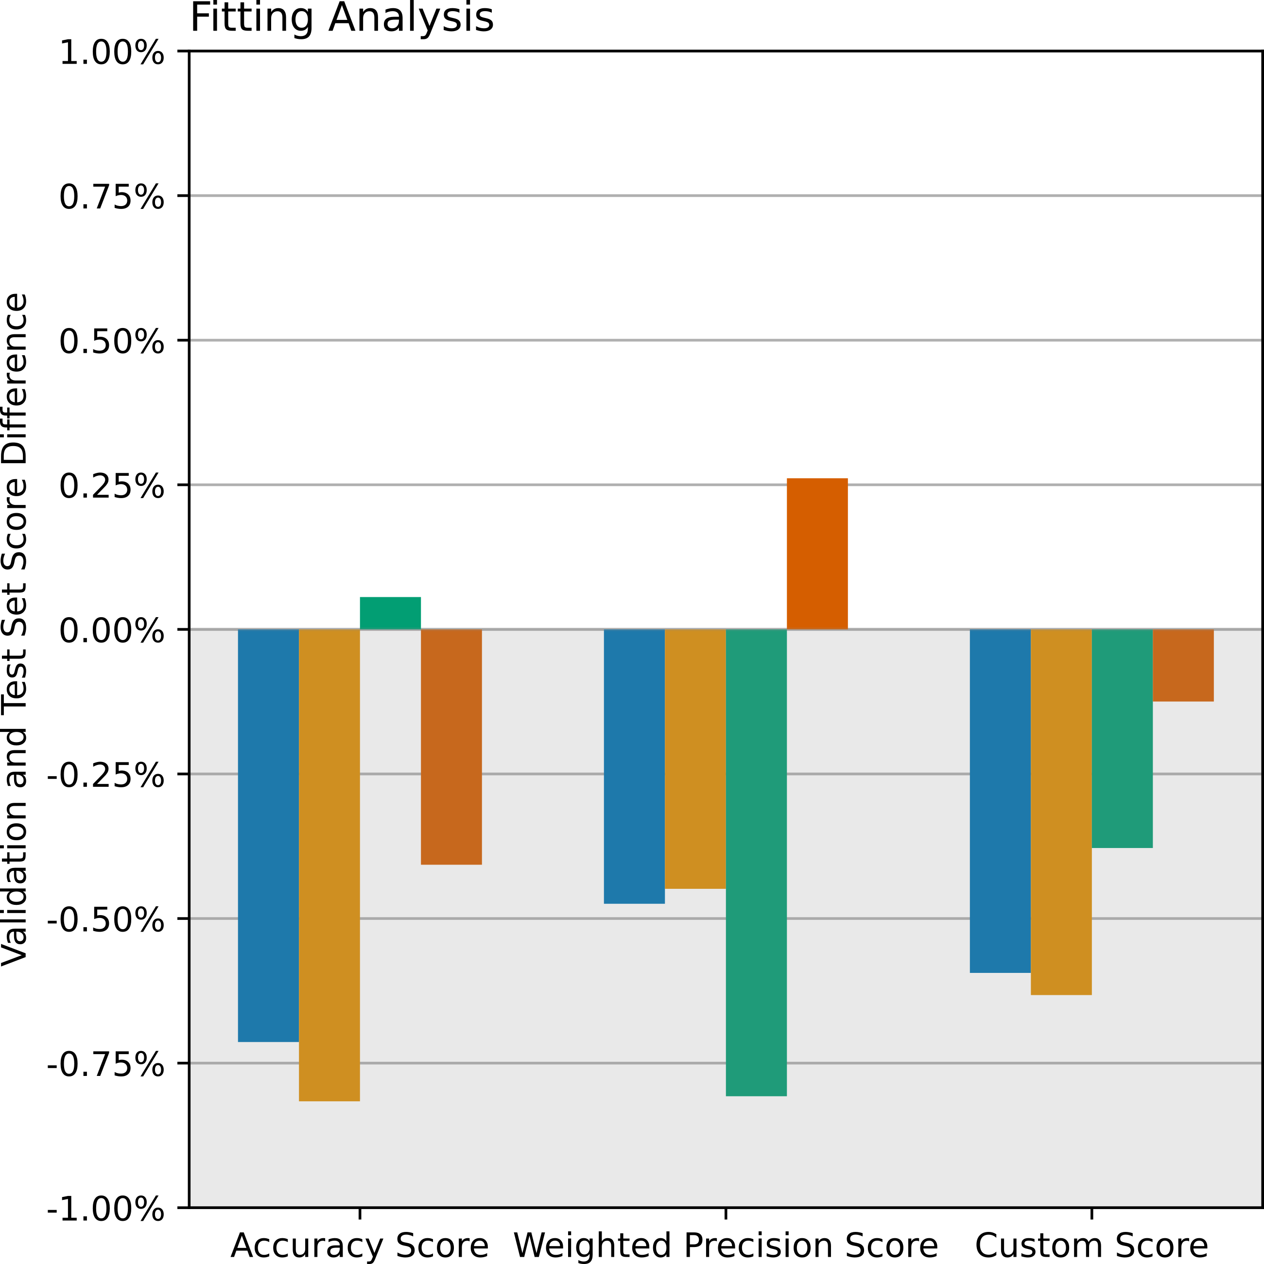
Evaluating Models
General Findings
  Most scores are underfitted

Slide 13
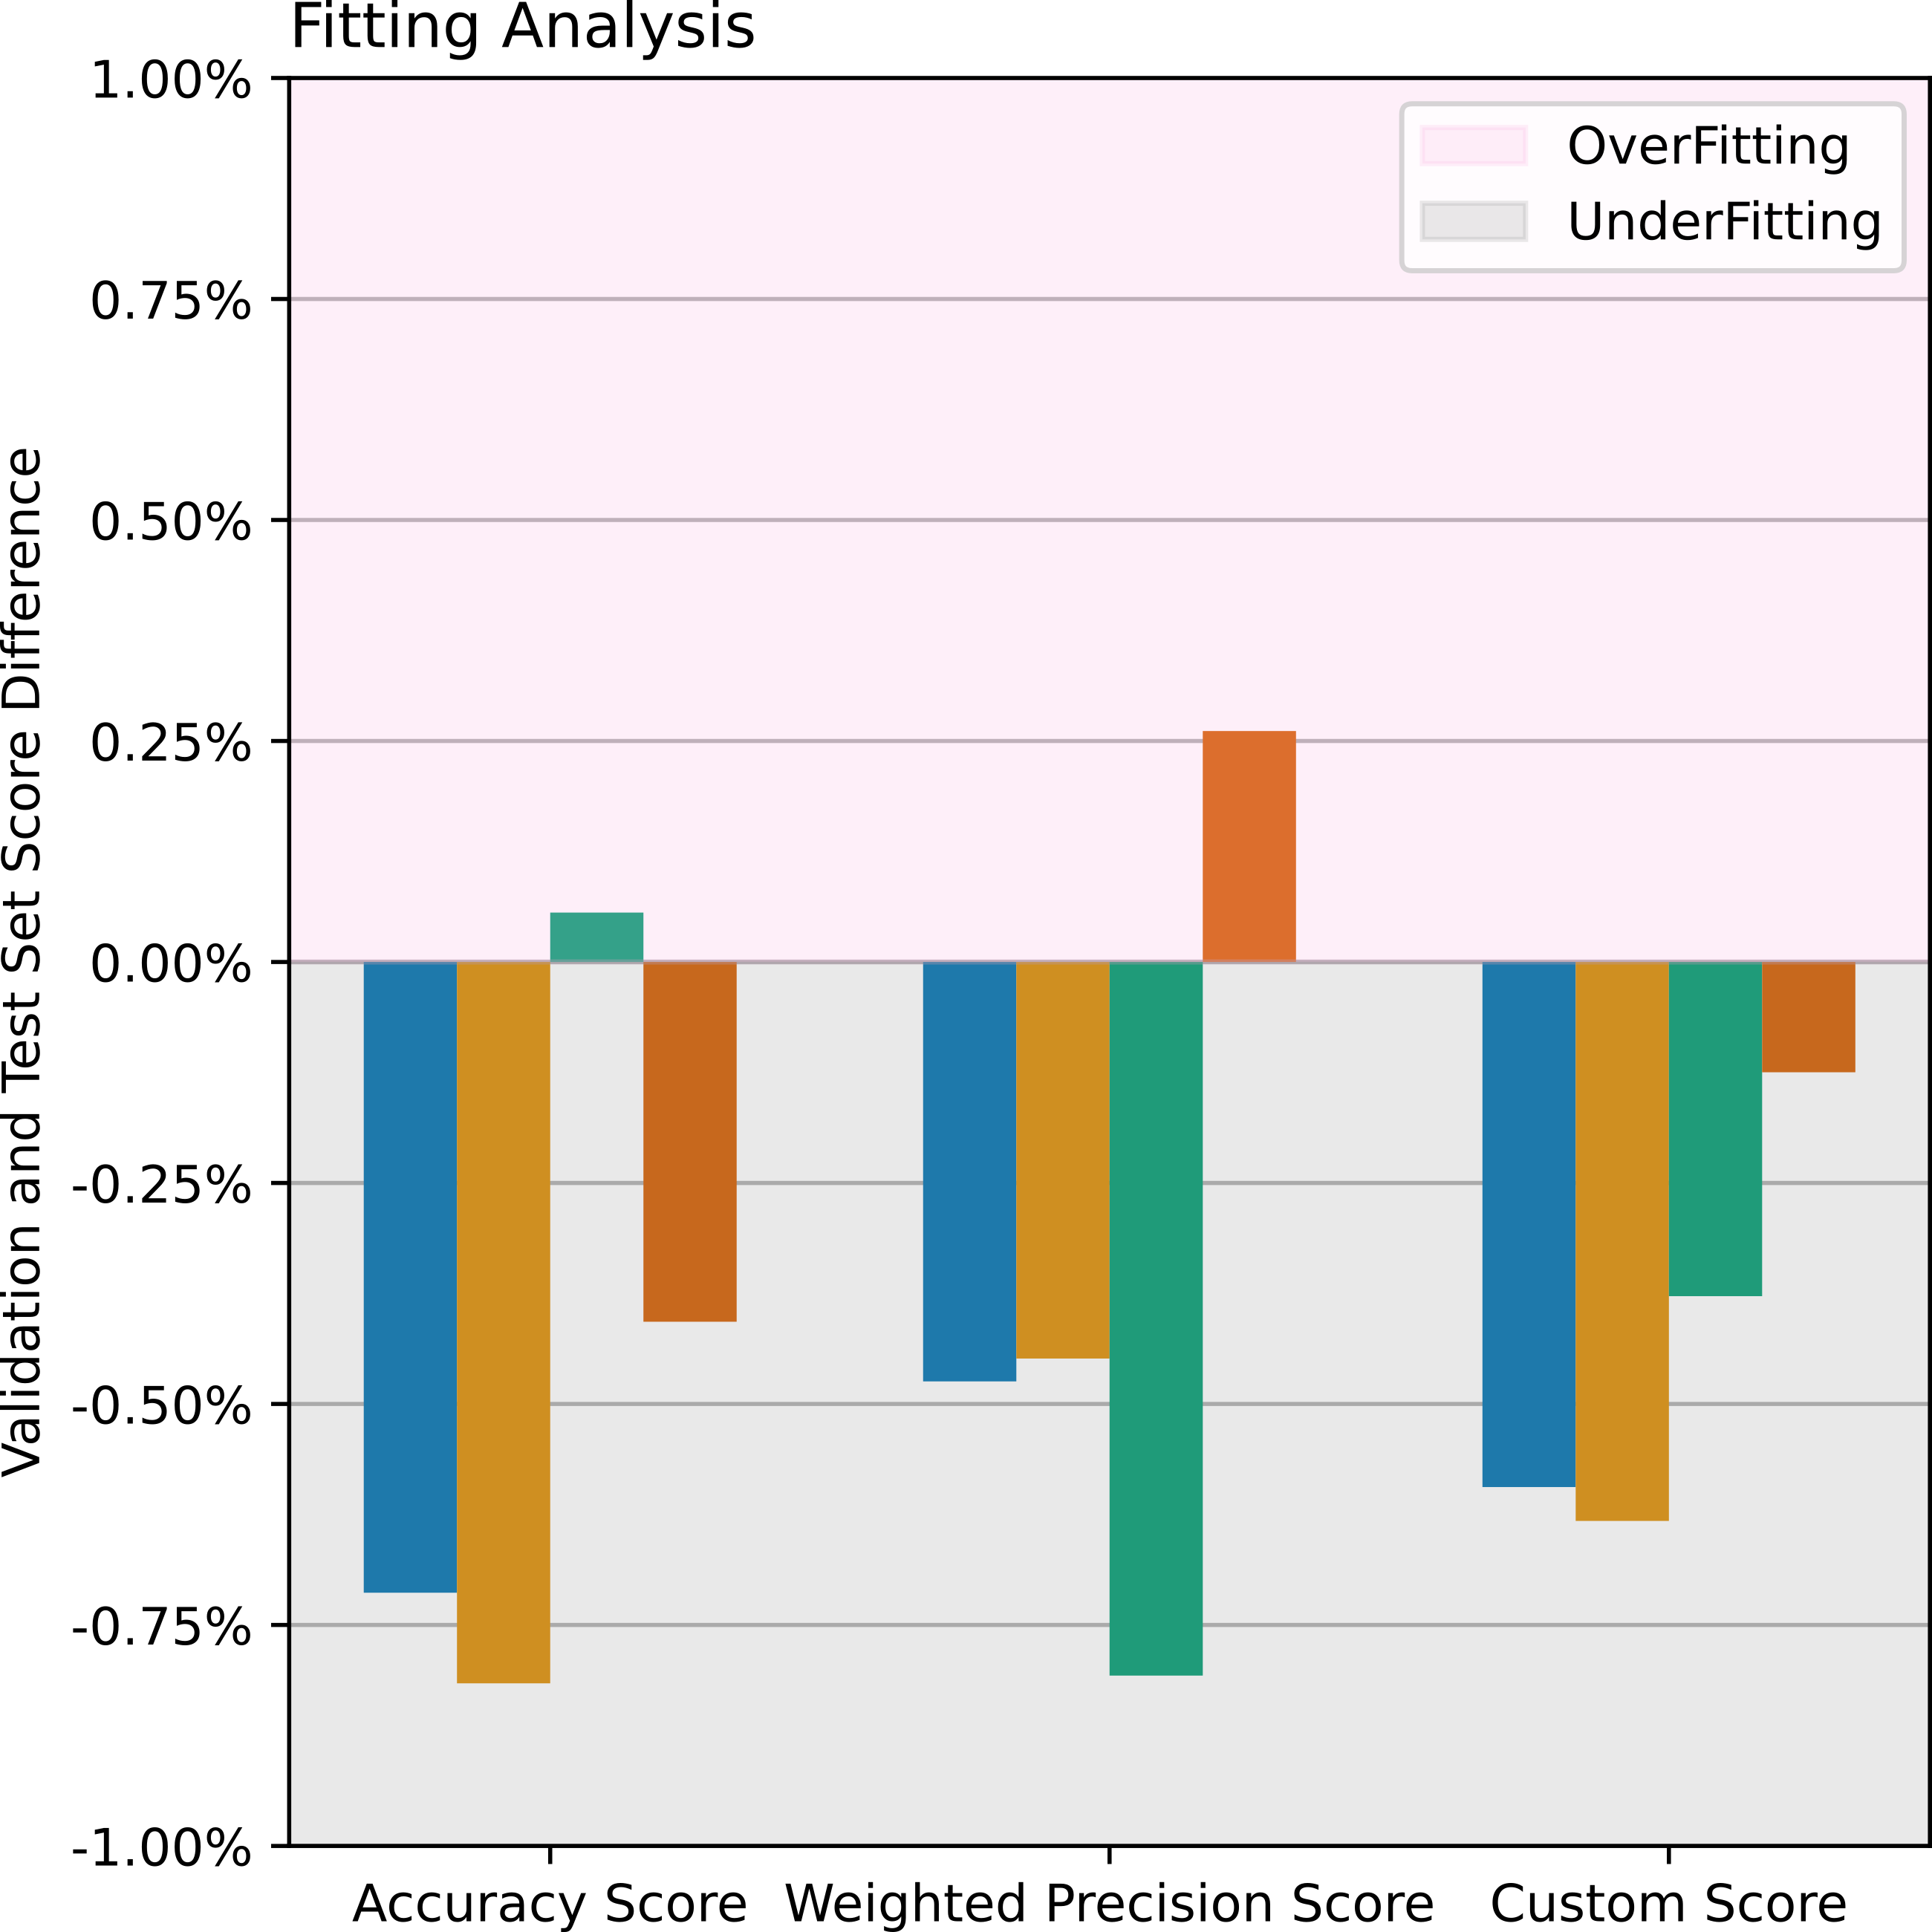
Evaluating Models
General Findings
  Most scores are underfitted
  Few Scores are overfitted

Slide 14
Evaluating Models
General Findings
  Most scores are underfitted
  Few Scores are overfitted
  Differences Between Scores are Within 1.05%

Slide 15
Evaluating Models
General Findings
For any model, accuracy or precision could not exceed 56%
Weighted precision and accuracy scores agree with results from Custom Score

Slide 16
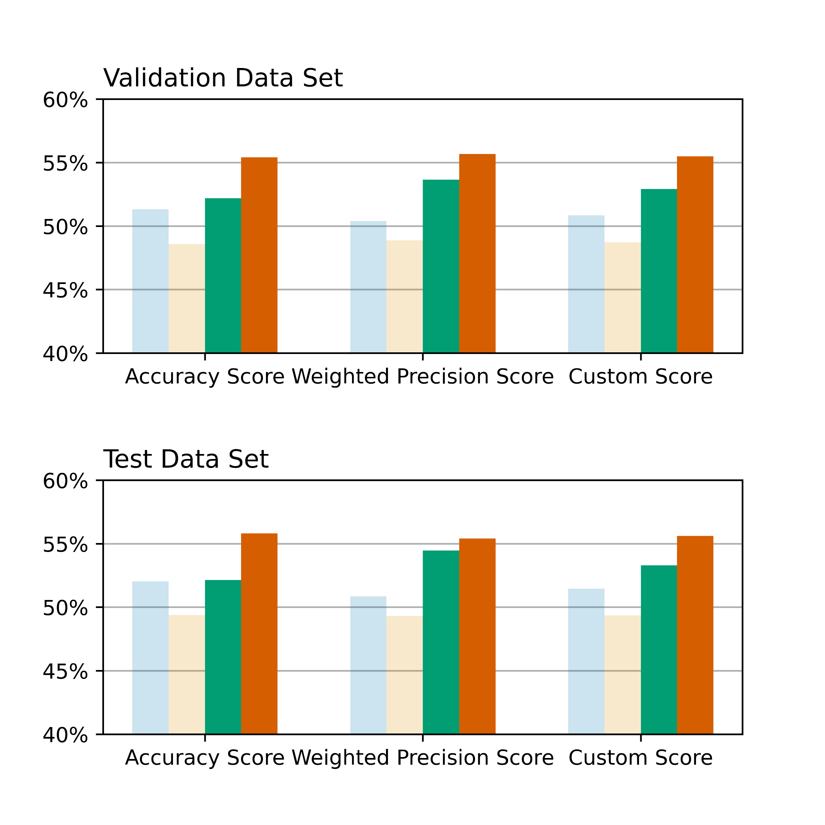
Evaluating Models
General Findings
Decision Tree & Random Forest outperformed Logistic Regression & KNN.
Relationships between entries is likely non-linear

Slide 17
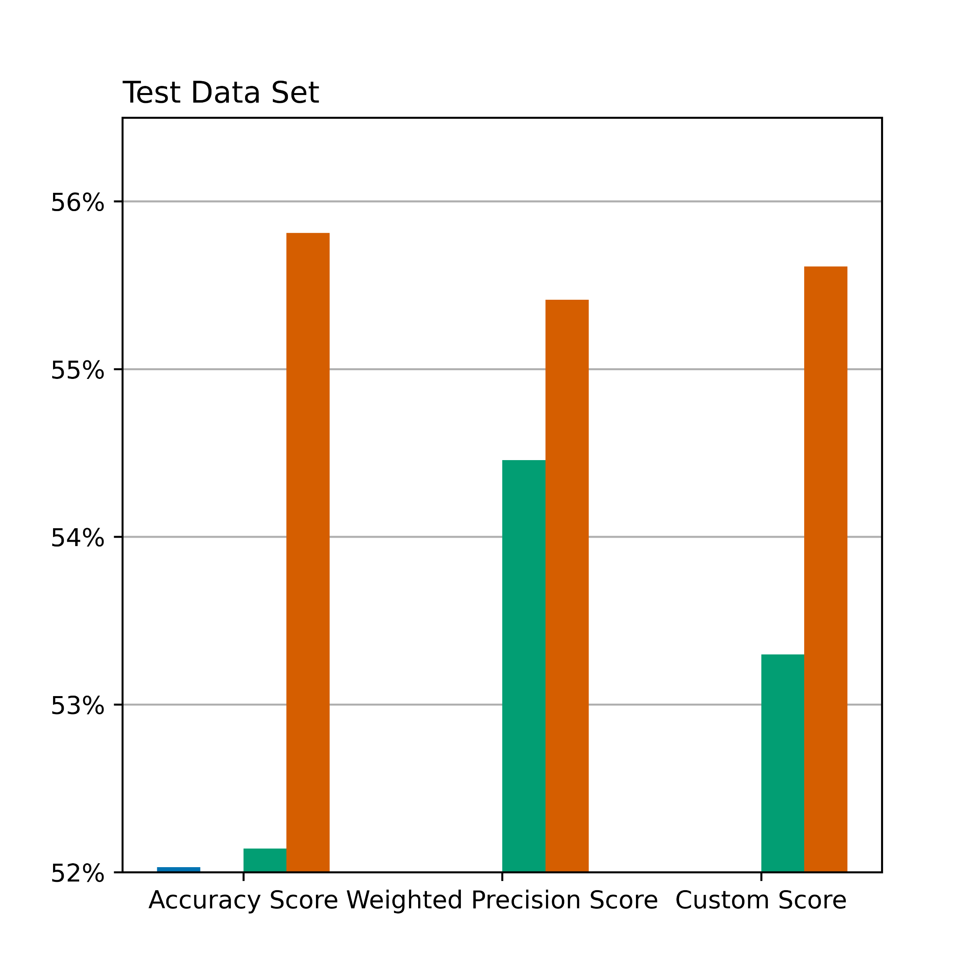
Evaluating Models
General Findings
Random Forest has higher accuracy than Decision Trees between 0.96-3.7%.
Improved accuracy likely due to reduced outlier sensitivity.
0.96%
3.7%
2.3%

Slide 18
Summary

